Slide 1
Bridge the Data from Edge to Cloud
Livia Xiang
Sep, 2019

Slide 2
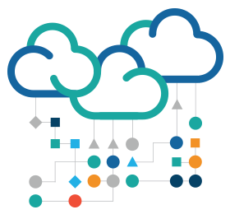
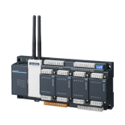
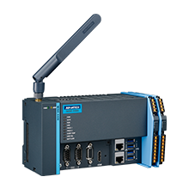
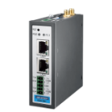
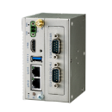
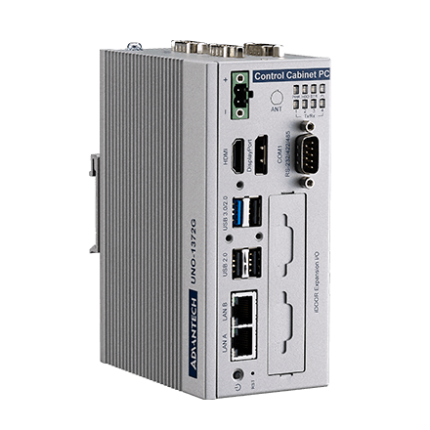
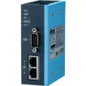
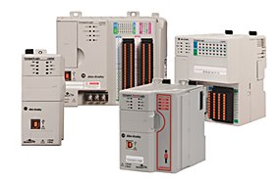
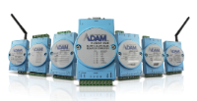
What is ?
Advantech IoT Communication Gateway Software without visualization
A Lightweight, cross-platform, edge-computing middleware
Runs on common operating system such as Linux
Provides a variety of industrial protocols for rapid collection of equipment data
Seamless integration to multiple cloud platforms and 3th party systems (MQTT, AMQP, Lwm2m, OPC UA, Modbus, IEC-104, DNP3……)
Can't be purchased separately, it requires bundle hardware
Powered by
PLC
Sensor & Meter
Remote IO

Slide 3
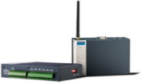
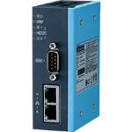
Overview
Supported Cloud
Data Backup
Data Forwarding Services
Event Management
FTP
File Server
Supported
Platforms
Linux(10+)
ADAM-3600
ECU-1000 ECU-4000
UNO
WISE
ADAM-3600/ADAM-3600-DS
ECU-1051TL/ECU-1152TL/ECU-1251TL/ECU-4553
UNO-1372G/UNO-2372G/
UNO-2271G/UNO-2484G
WISE-710
Drivers
(200+ kinds of device)
Data Collection
Protocol Conversion

Slide 4
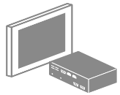
Architecture
Advantech WISE-PaaS/EdgeLink is equipped key functionalities for edge applications. With the integrated abilities of downlink for data acquisition and uplink with connectivity, security, and intelligent functionalities, sending field data to the cloud becomes an easy task.
Application
Intelligence
MES
SCADA
Private Program
Database
Edge Computing
Data Acquisition
PLC & I/O drivers
Standard protocol drivers
User tags
System tags
Connectivity
Active connection to WebAccess
Store and forward
Protocol support
MQTT/FTP/ODBC/AMQP
WebService/RESTful
Security
Project encryption
Whitelisting
SSL encryption
Data authority management
Open VPN
Intelligence
Event hub for SMS/email notification
Softlogic runtime
Data log with Time stamp and quality
Sensor & Data
Networking
Ethernet
Switches
Data Modules
Sensor
Database
Smart Meter
PLC & PACs
Machines
Industrial HMI
Remote IO

Slide 5
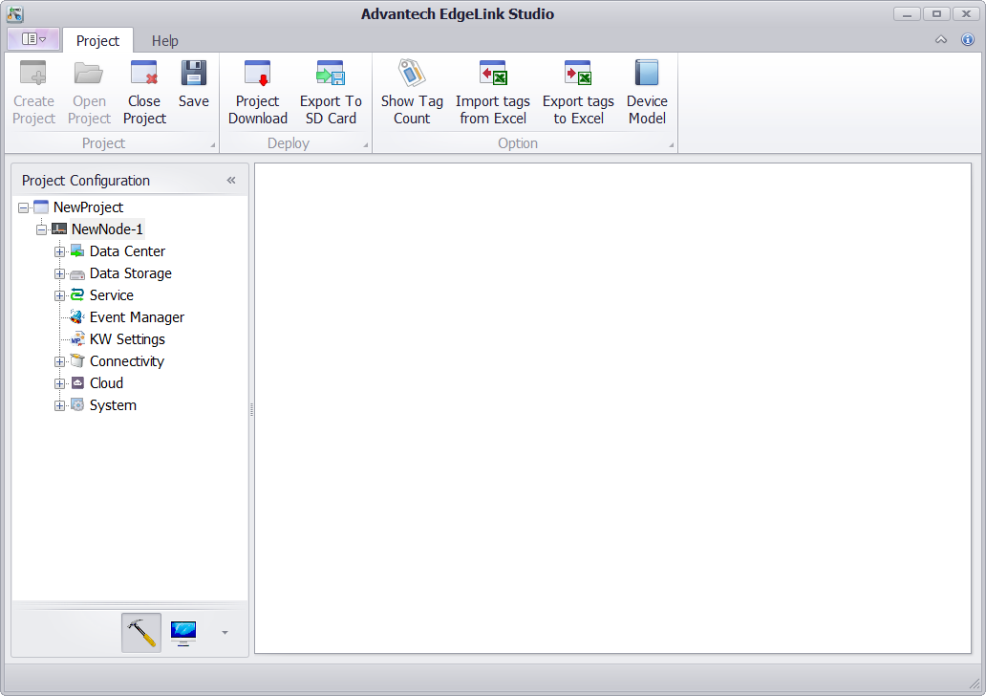
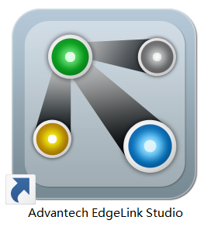
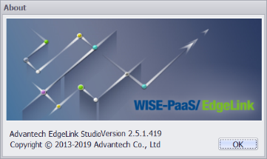
Component
Edgelink Studio (For Windows)
Project Configuration
Online Device Monitoring
Device Communication Setup
Data forwarding Settings
System Setting
Download the project to platform through network
Edgelink Runtime (For Liunx)
Connect end devices
Data acquisition and transmission
Support 200+ device drivers
Real-time and historical data log
Connectivity to the Cloud and 3th party systems
configuration files
* Only support the hardware platforms that have been bundled Edgelink

Slide 6
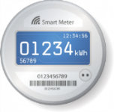
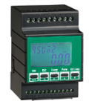
Equipment connection and Data Acquisition
EdgeLink supports more than 200 I/O Drivers
Standard Industrial Protocols
Industrial communication device: PLC, Smart meter, Sensor
Energy management: Power meter, Solar inverter
Export and Import I/O tags by excel
Define your own device template
PLC, PAC, I/O Module……
EdgeLink supports user-defined acquisition period
User can set the different scan time for each interface
Reduce the CPU loading
Raise the update rate for important data (100Hz)
Support retry and timeout setting
Edgelink provides System Tag to monitor device anytime
Power Meter
DL645_2007
DL645_1997
IEC 62056-21
IEC 60870-5-104
DNP3.0（Only ADAM-3600 supported)
Modbus/RTU
Modbus/TCP
Each external device has a system point to identify connection status
Alarm notification
Master your system
System : CPU / RAM / TF Card / SD Card/ NodeID
Wireless Connection : Mobile / WLAN
Wired Connection : Serial / Ethernet
GPS : Latitude / Longitude / Altitude / Satellite / Speed / Course

Slide 7
Connectivity with 3th party systems
Private Cloud
Private Program
WebAccess/SCADA
Other SCADA Systems
Active Connection (WASCADA)
MQTT
Modbus/RTU
Modbus/TCP
OPC UA
IEC-104
DNP3 (Only for ADAM-3600)
ERP
Modbus/RTU
Modbus/TCP
OPC UA
IEC-104
DNP3 (Only for ADAM-3600)
MQTT
Webservice
ODBC
JDBC
Database
MES/ERP
FTP
FTP Server

Slide 8
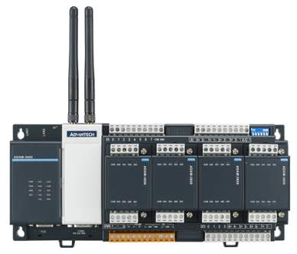
Security
Authentication
CRT / Key pairing
Username / Password
Web Service
HTTPS by SSL
MQTT with TLS
010101110101010101110101
Transmission
White list
Open VPN
Security by encryption
Unique IP address in VPN for Server/Client protocol (like Modbus) and device management
Transmission of encryption
BF-CBC (Default)
AES-128-CBC
AES-256-CBC
DES-EDE3-CBC
All processes run as non-privileged account to reduce the risk of attack
Configuration
001110101001110101
User/Password Login
User level Management
All configuration parameter encrypted by AES-256
Project file encrypted by AES-256
MD5 check for project upgrade

Slide 9
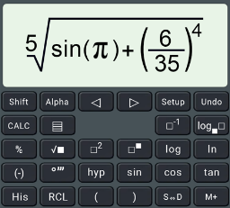
Data Processing Intelligence
Sensor & Data
Networking
Soft Logic Runtime
ECU
UNO
Calculation Tag
KW Service Enable
Sensor
Add-On for KW MULTIPROG
Data Log
Smart Meter
PLC & PACs
Select available storage devices
ADAM-3600
WISE
Notification
Remote IO
SMS
eMail
Database
Event Management

Slide 10
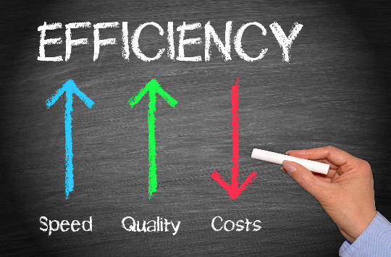
Benefits
Optimizing Efficiency with Connected Equipment
“Click-and-Go”
Cloud Access Fast Deployment
Integrating with 3th party system with Secure Data Conversion
For industrial boilers, air compressors, chillers, power distribution cabinets, and other equipments, Advantech WISE-PaaS/EdgeLink serves as a hub for data acquisition, data storage, alarm notification, data reporting, and other functions, maximizing equipment efficiency with reliable data.
Advantech WISE-PaaS/EdgeLink Studio offers a “click-and-go” function for sending data to the cloud.
Acquired data can be easily and effortlessly uploaded for analysis and visualization to serve as a more useful reference for management.
Supports data conversion, enabling equipment used in mass production, such as PLCs, sensors, inverters directly integrated with SCADA, manufacturing execution systems (MESs), and ERP systems, thus facilitating equipment operation and maintenance.

Slide 11
Contact Information
Livia Xiang, PM
VOIP: 523 6507
Email: Livia.Xiang@advantech.com.tw
Jasmine Chiang, Marketing
VOIP: 511 7476
Email: Jasmine.Chiang@advantech.com.tw
For ECU-1000/ADAM-3600 Platform
For UNO & WISE-710 Platform
Luke Cheng, Product AE
VOIP: 511 7397
Email: Luke.Cheng@advantech.com.tw
Haley Chang, Product AE
VOIP: 511 7510
Email: Haley.Chang@advantech.com.tw
Fu Yu, Product AE
VOIP: 523 6512
Email: Yu.Fu@advantech.com.cn
Nick Liu, Solution AE Leader
VOIP: 511 7709
Email: Nick.Liu@advantech.com.tw
Black Chang, Solution AE
VOIP: 511 7178
Email: Black.Chang@advantech.com.tw
William Lin, Solution AE
VOIP: 511 7601
Email: William1.Lin@advantech.com.tw

Slide 12
Go Together,
We Go Far and Grow Big

